Slide 1
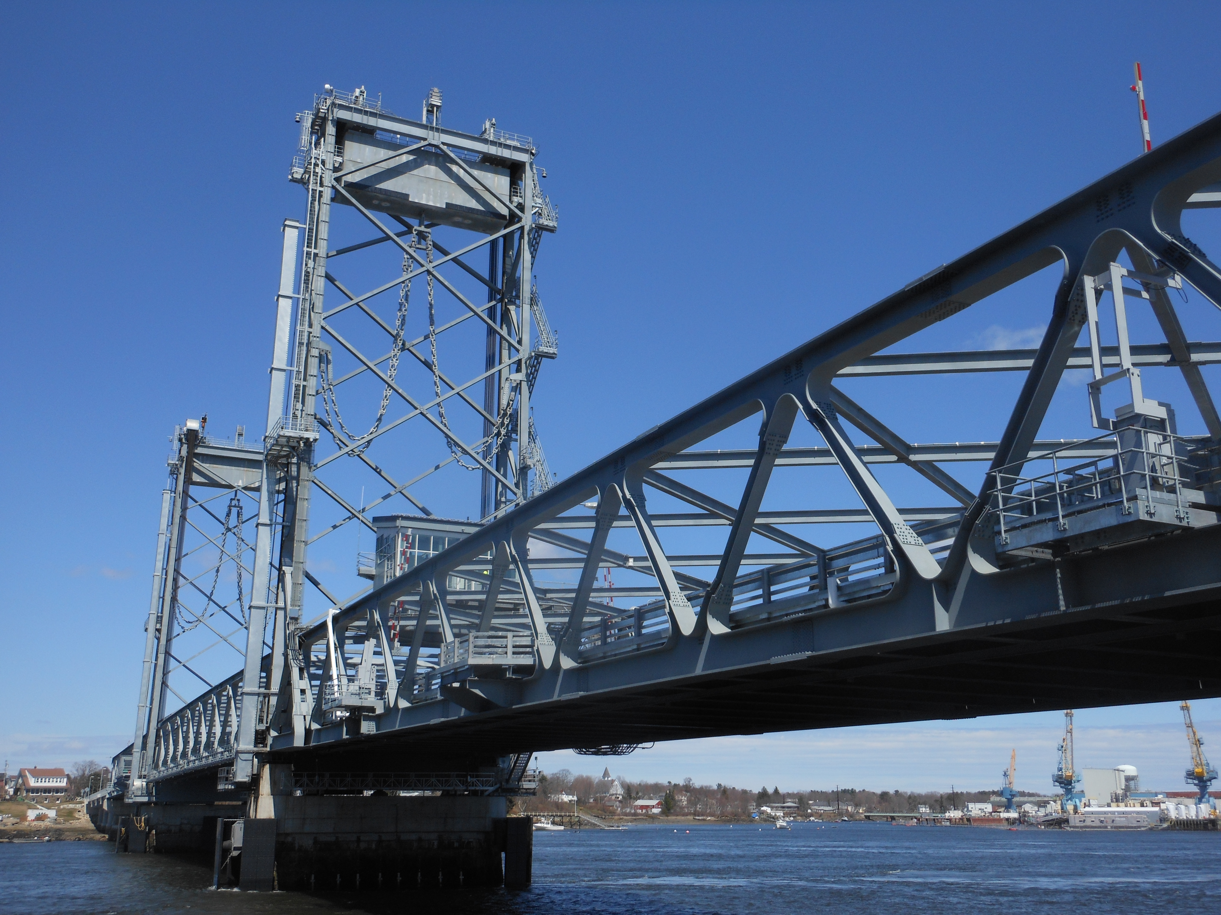
Benefits of Design-Build
ACEC of New Hampshire Winter Conference - January 10, 2020

Slide 2
Benefits of Design-Build
Owner’s Perspective

Slide 3
Benefits of Design-Build
Designer’s Perspective

Slide 4
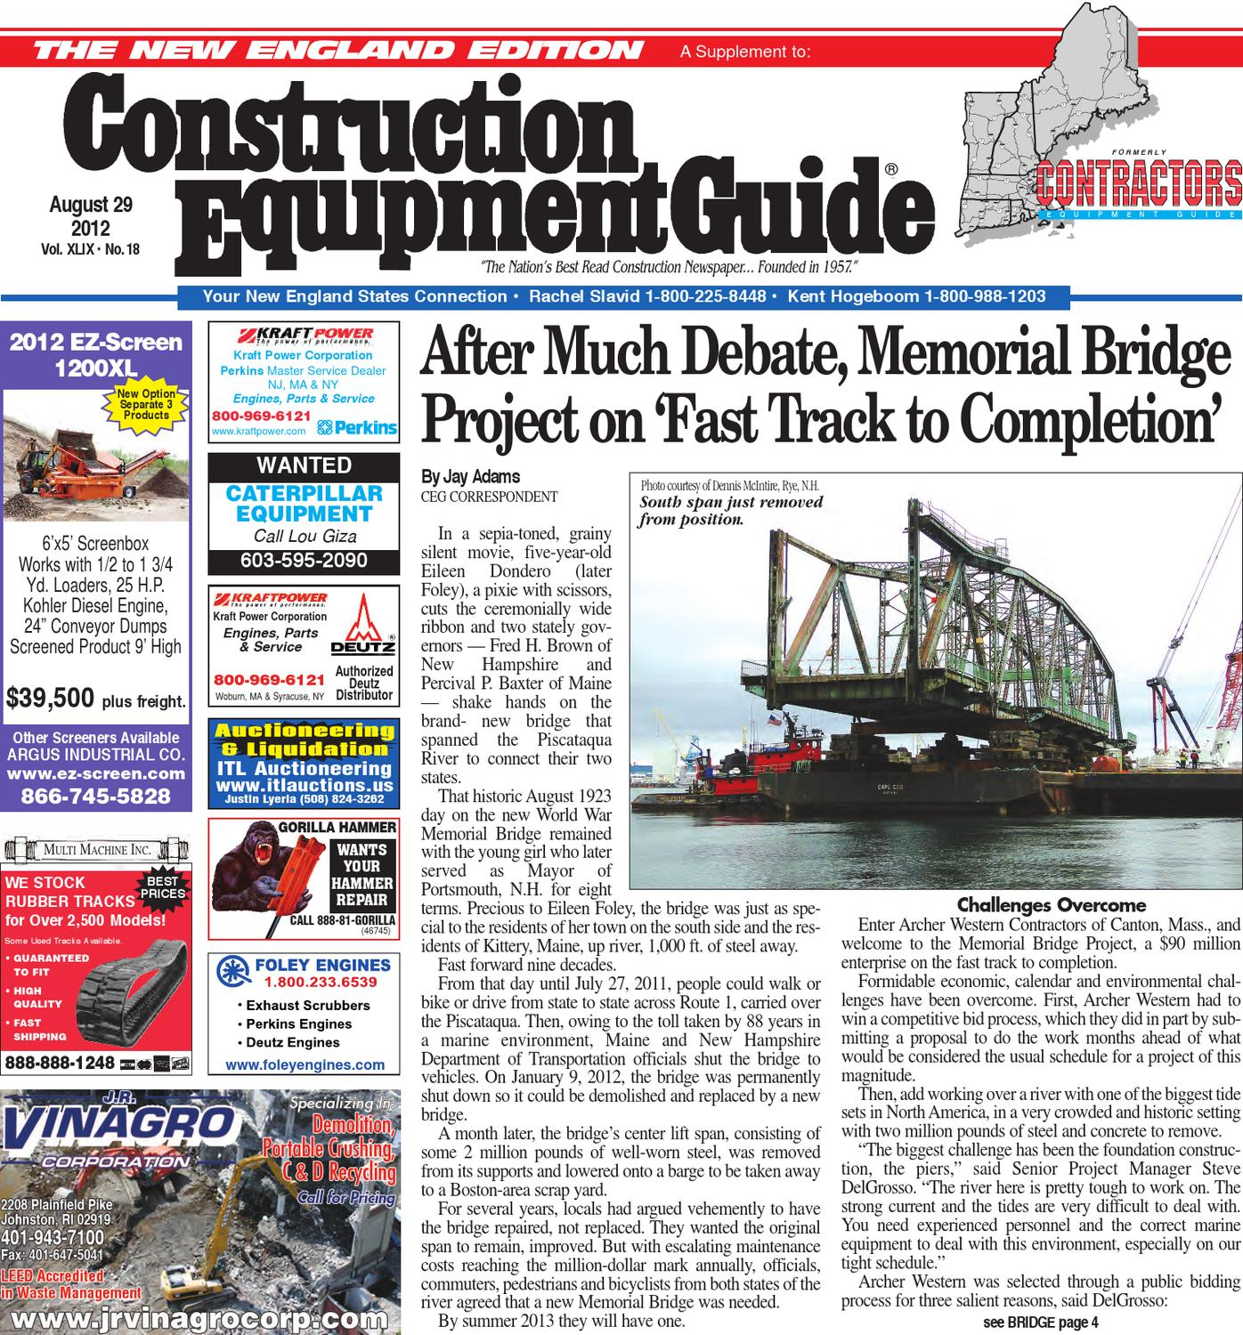
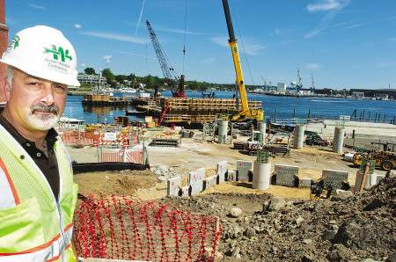
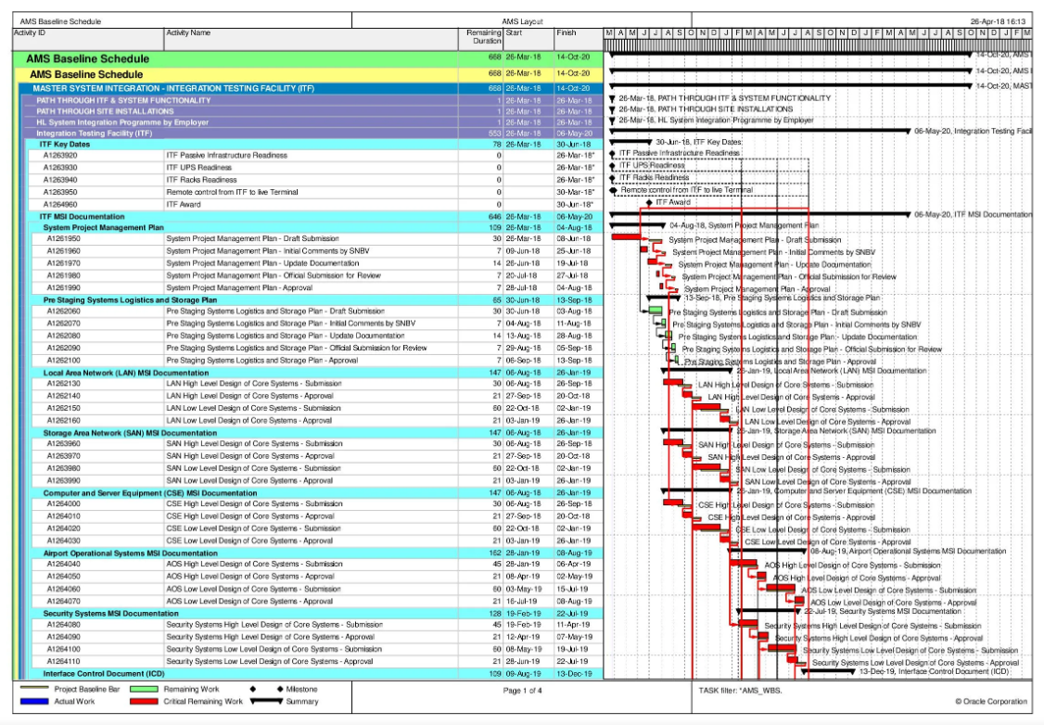
Benefits of Design-Build
Contractor’s Perspective

Slide 5
Benefits of Design-Build
Single Point of Responsibility
Contractor
Designer
+
=
Designer-Builder

Slide 6
Benefits of Design-Build
Continuity and Coordination

Slide 7
Benefits of Design-Build
Risk Management

Slide 8
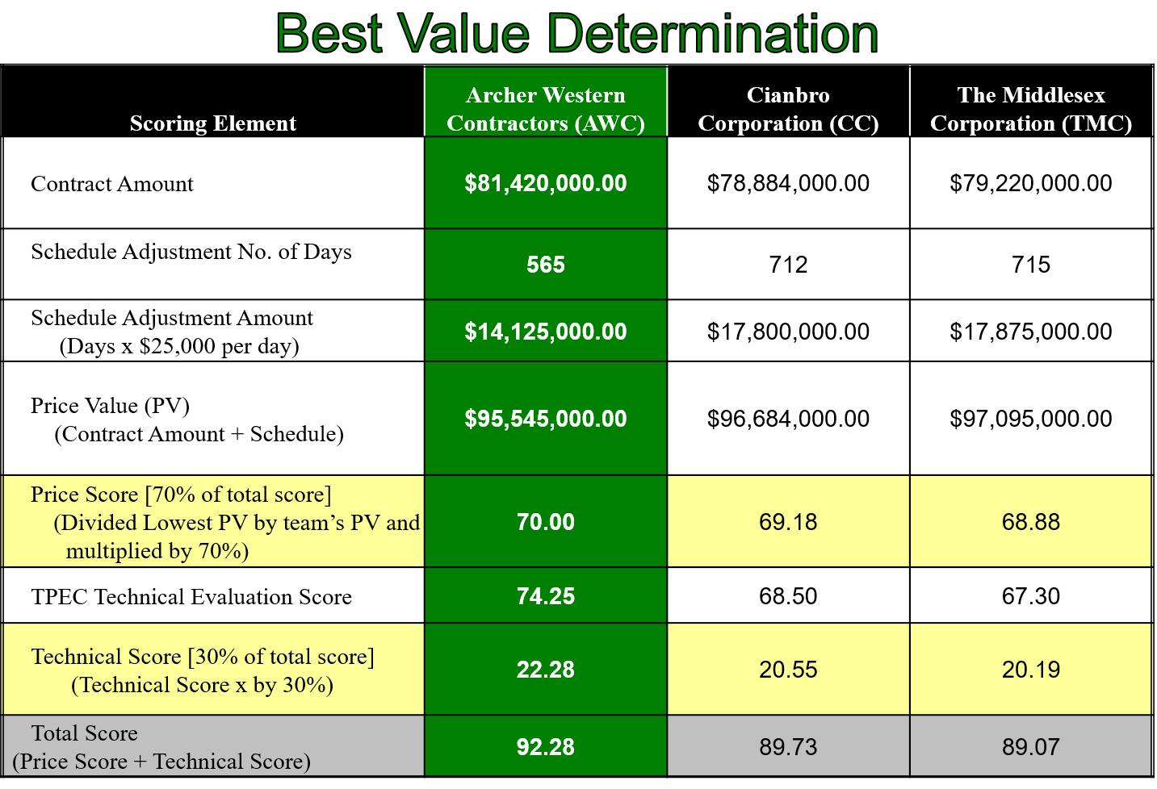
Benefits of Design-Build
Accelerated Delivery

Slide 9
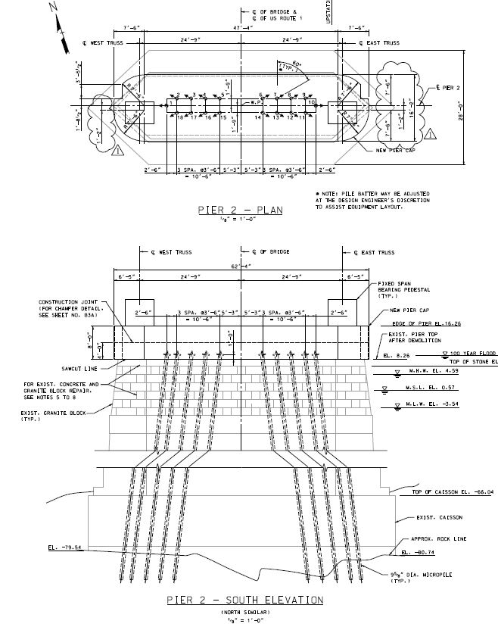
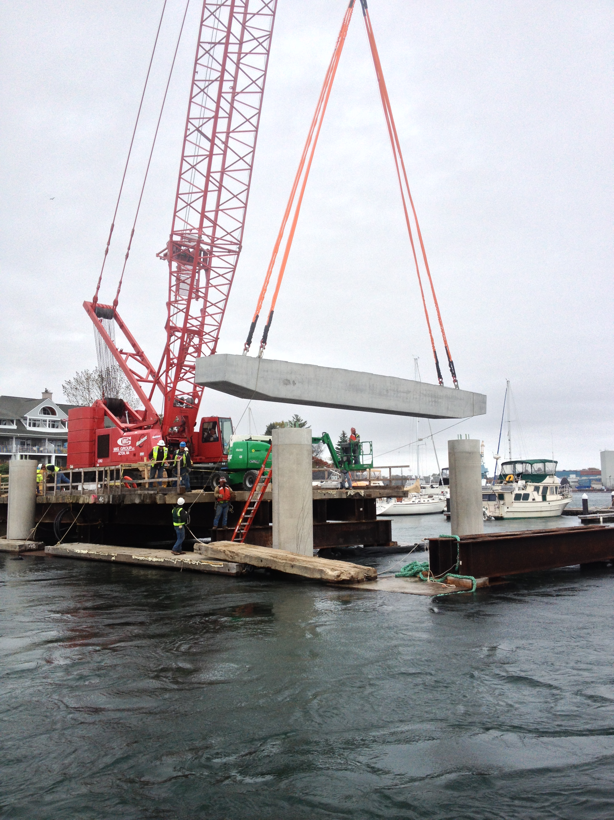
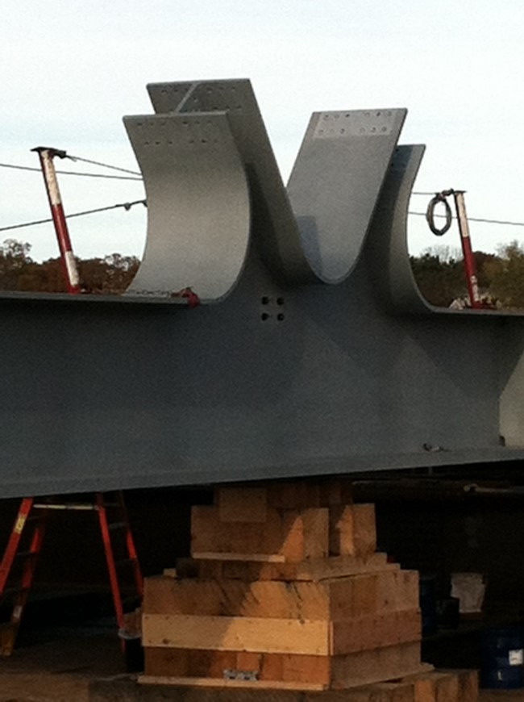
Benefits of Design-Build
Design Alternatives

Slide 10
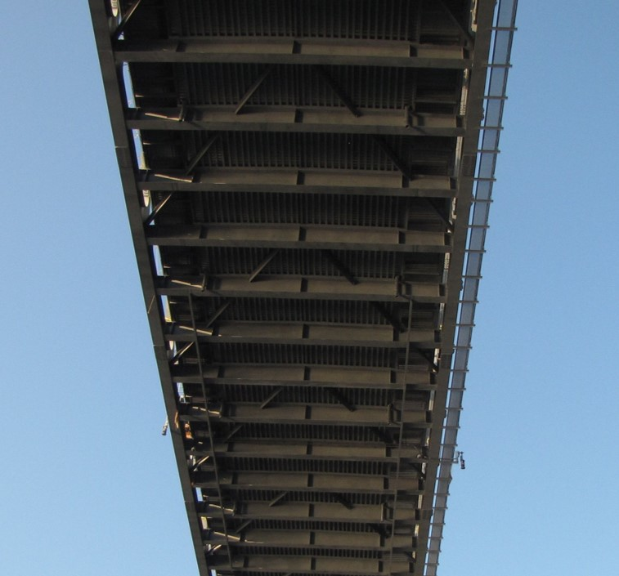
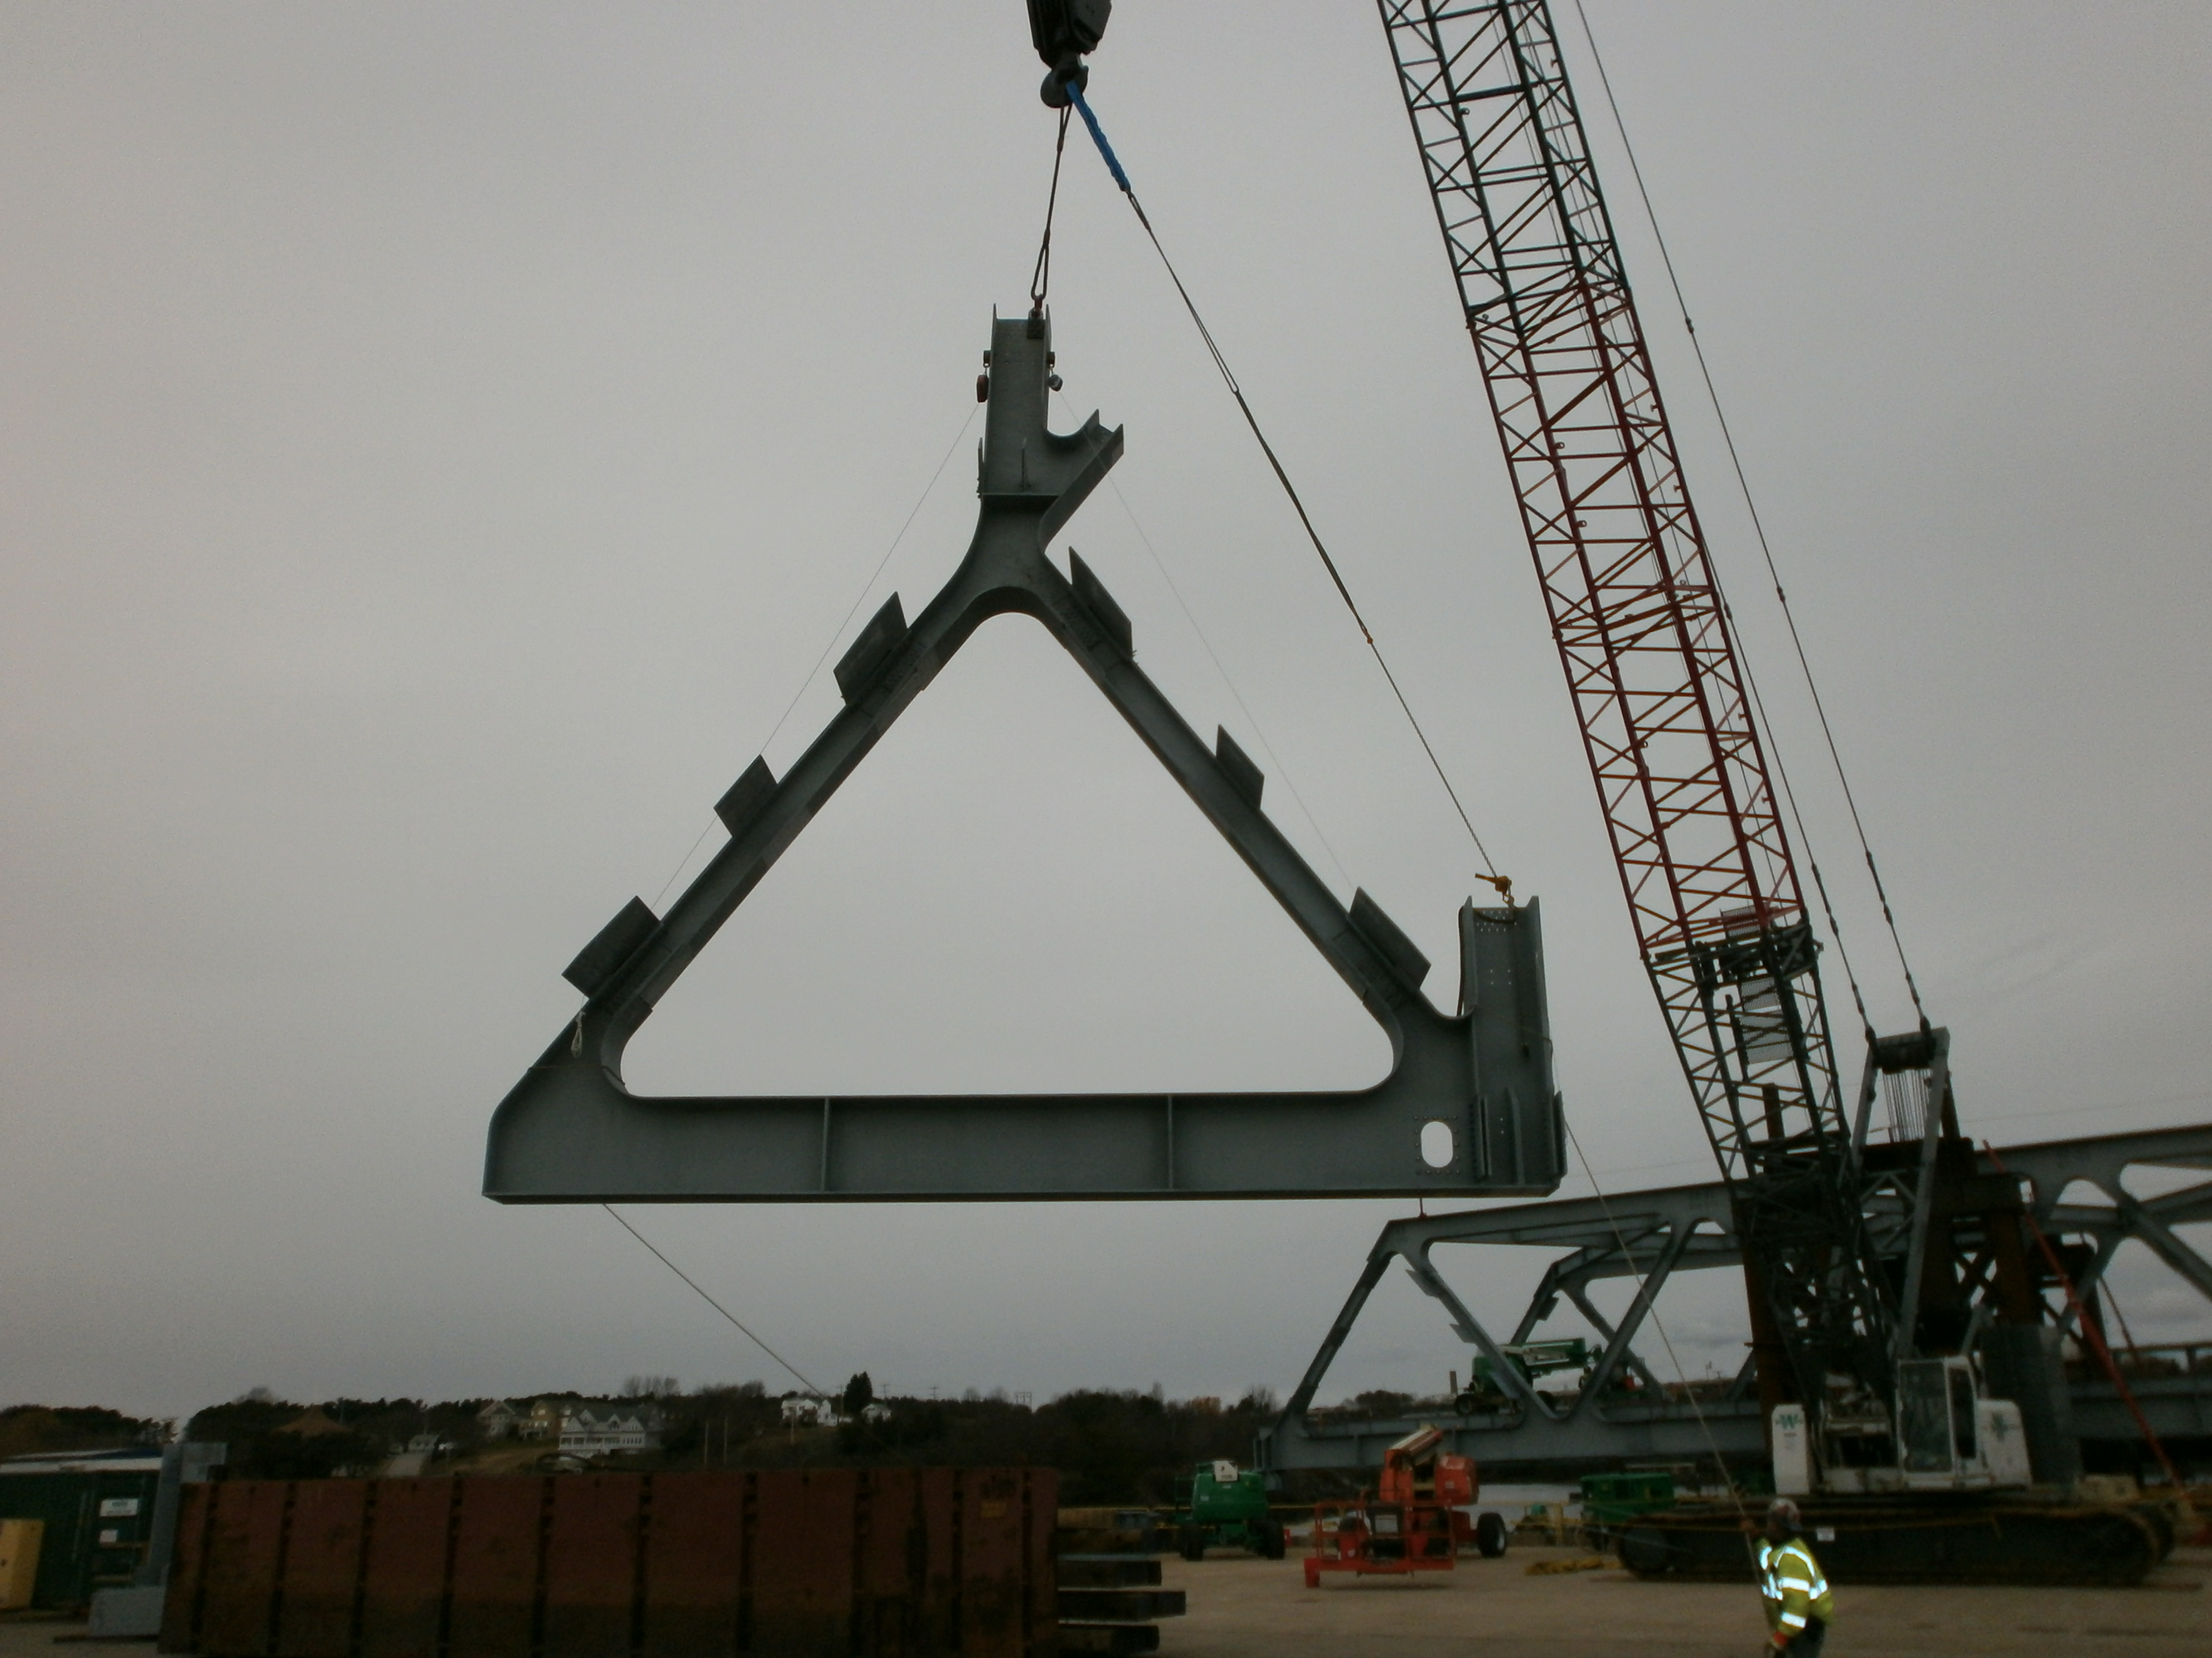
Benefits of Design-Build
Improved Constructability

Slide 11
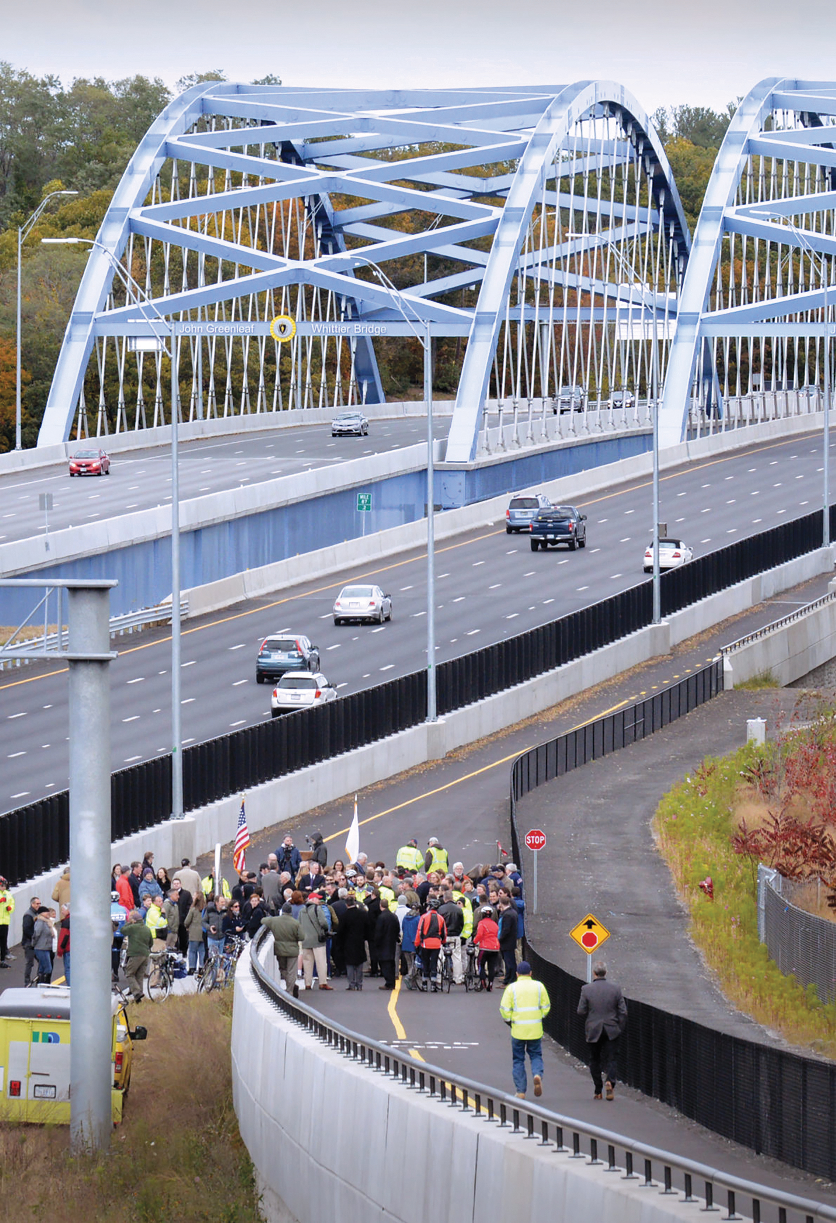
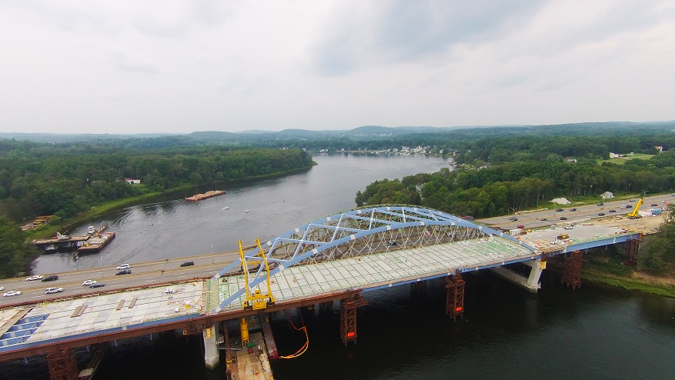
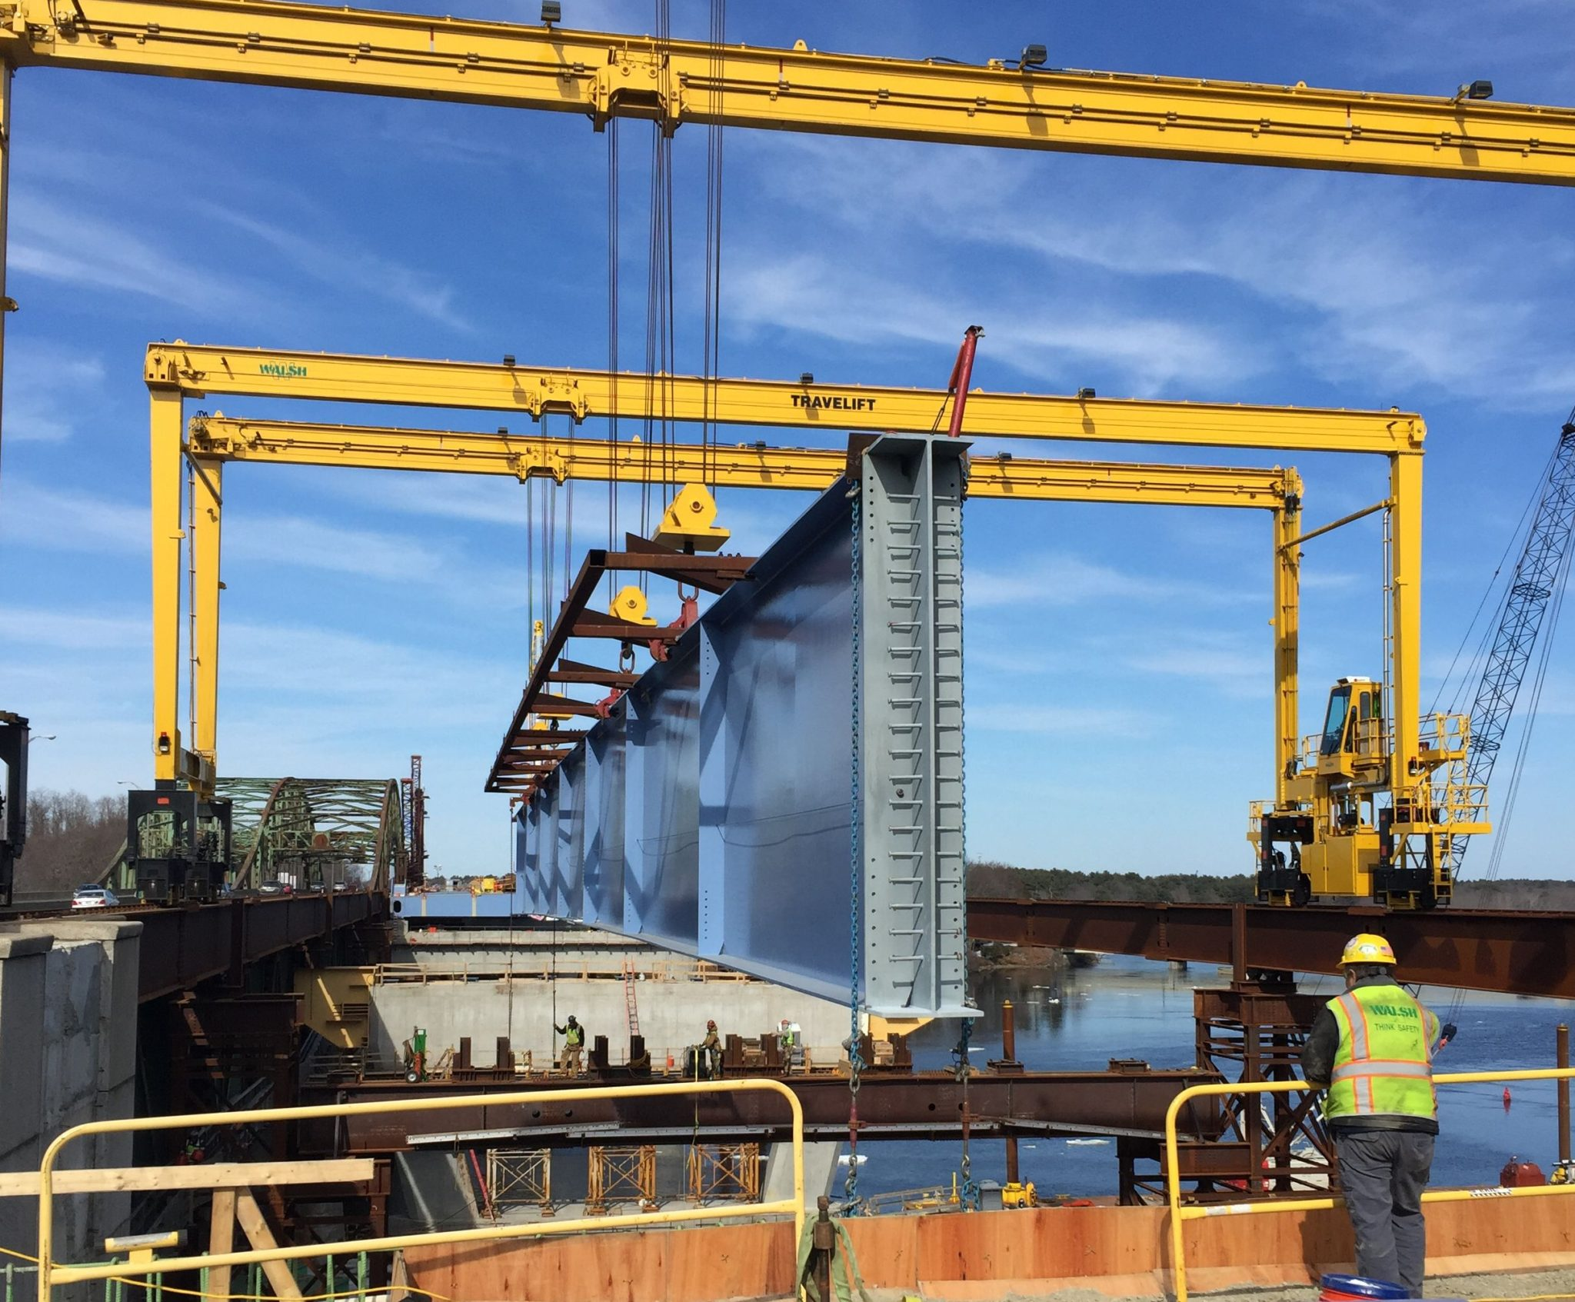
Benefits of Design-Build
Whittier Bridge, MassDOT

Slide 12
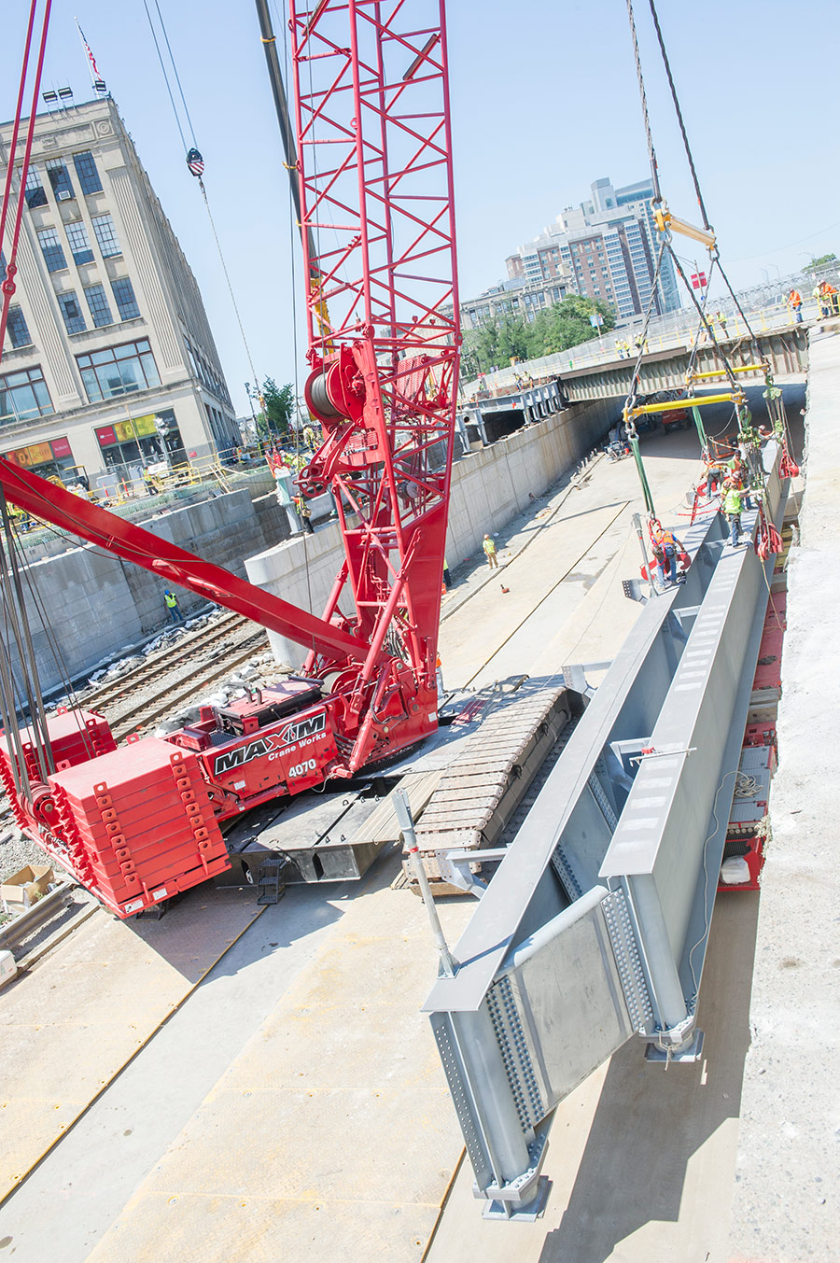
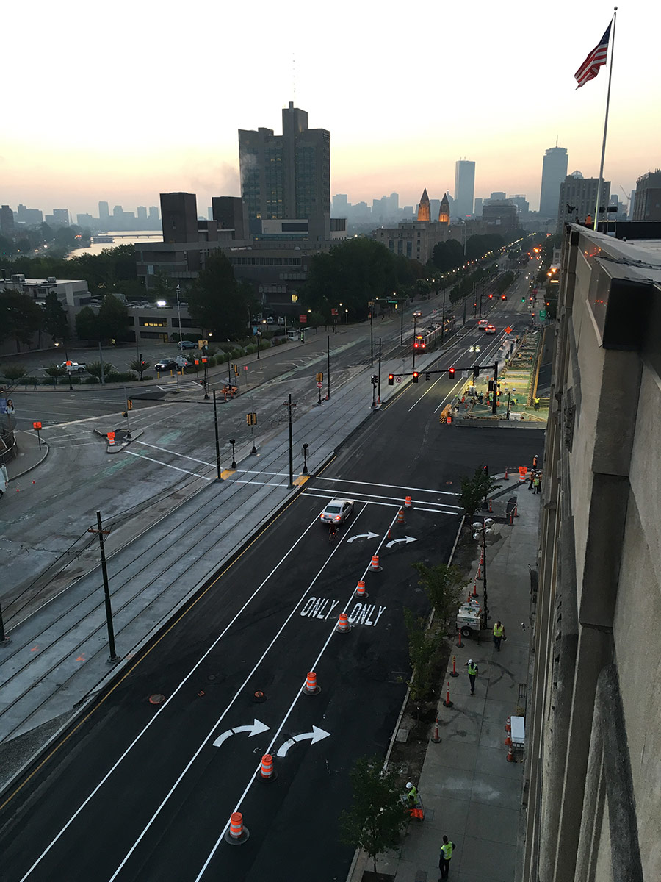
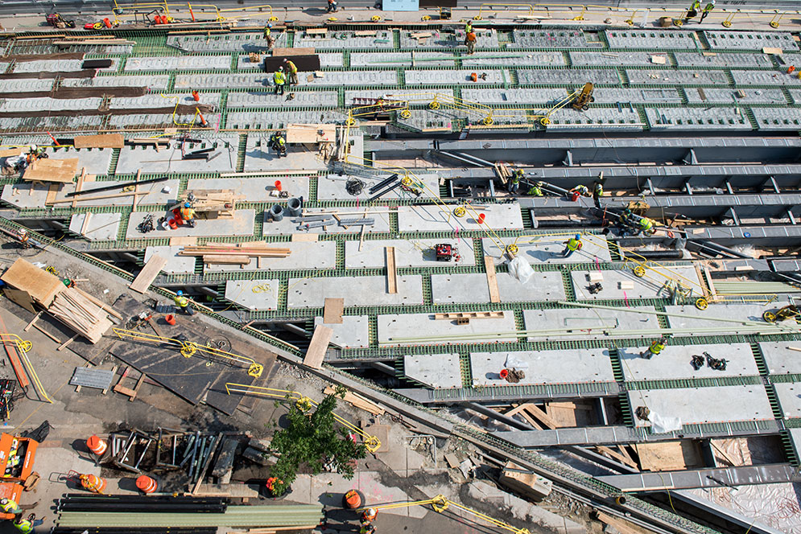
Benefits of Design-Build
Commonwealth Ave Bridge
MassDOT

Slide 13
Benefits of Design-Build
Collaboration, Trust

Slide 14
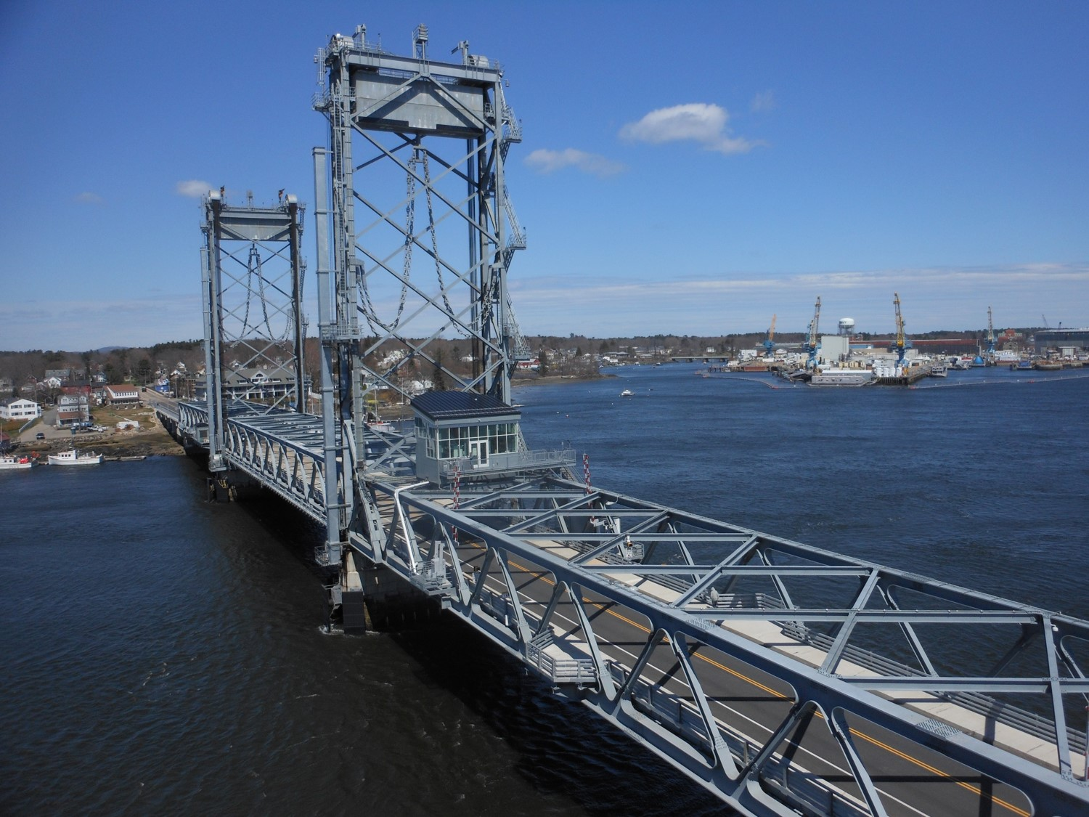
Benefits of Design-Build
Success

Slide 15
Benefits of Design-Build

